Slide 1
COVID-19 Relief and the New Federal Lending and Grant Opportunities
Nonprofit Financial Managers
April 7, 2020
Notes:
Melissa/Danielle

Slide 2
Learning Objectives
Introduction to the new federal lending and grant opportunities
Understand the critical interpretations of the Paycheck Protection Program (PPP) loans
Describe other business opportunities for nonprofits in the current operating environment
Notes:
Melissa/Danielle

Slide 3
COVID-19 – SBA & CARES Loans
SBA – Economic Injury Disaster Loans (EIDF)
Apply directly with the SBA
CARES ACT – Paycheck Projection Program (PPP)
Loans are made through 7(a) lenders and other designated institutions
Continues to evolve daily and some items remain unclear

Slide 4
EIDL vs PPP Comparison
Comparison tool located at https://www.claconnect.com/resources/articles/2020/comparison-of-eidl-and-paycheck-protection-programs
Includes matrix comparison of loan programs

Slide 5
Paycheck Protection Program Loan Features

Slide 6
CARES Act – Paycheck Protection Program
Main purpose is to incentivize employers to retain employees while also assisting to cover debt service and certain operating costs (25% limit)
100% federally guaranteed loans
Available to small businesses and nonprofits (501(c)3 and 501(c)19)
May be forgiven if employers meet certain requirements
No collateral requirement

Slide 7
CARES Act – PPP Features
Loans up to the lesser of $10 million or 2.5 average monthly payroll
Exclusions apply for annual salaries exceeding $100,000
Interest rate at 1%
Term – 2 years
6 month deferral period
Loan proceeds cover qualifying expenses for an 8 week period

Slide 8
CARES Act – PPP Features
When: Applications started April 3rd and will start on April 10th for independent contractors and self-employed
Where: Applications are taken directly by the lender (not the SBA)
How Long: The program technically is open until June 30th, 2020; however, demand is expected to be high and speculation is that funding will run out
How Many: Only 1 loan per organization

Slide 9
Eligibility Matters
Qualifying nonprofits with less than 500 employees (not FTE’s, think headcount) are eligible for PPP
Revenue size is not a consideration for nonprofit eligibility
Be careful about affiliation rules, the 500 employee limit generally applies to all affiliates aggregated (with certain exceptions for accommodation and food service, franchises and other businesses under section 301 of Small Business Investment Act)

Slide 10
Loan Process – Think 2 Steps
Calculating the Size of the Loan
Calculating the Amount of Forgiveness

Slide 11
PPP Loan Size Determination
If you were in business for all of 2019: Your max loan is equal to 2.5 times your average monthly payroll costs during 2019
If you were not in business for all of 2019: Your max loan is equal to 2.5 times your average monthly payroll costs between January 1st, 2020 and February 29, 2020

Slide 12
What Costs are Eligible
Salary wage, commission, payment of cash tip or equivalent
Payment for vacation, parental, family, medical or sick leave
Payment required for the provisions of group health care benefits, including insurance premiums
Payment of retirement benefits
Payment of state or local tax assessed on compensation of employees

Slide 13
What Costs are not Eligible
Employee payroll costs over $100,000 salary
Compensation of employees whose principal place of residence is outside the U.S.
Qualified sick and family leave for which a credit is allowed under sections 7001 and 7003 of the Families First Coronavirus Response Act

Slide 14
Hot Topics/Lessons Learned
In the absence of further guidance the average monthly payroll should be calculated based on 2019 calendar year payroll data
Several interpretations of the $100,000 compensation cap have been outlined.
The cap is applied to $100,000 which includes all salaries and benefits
The cap is only to salaries and then benefits are added
Ask your Bank!

Slide 15
Hot Topics/Lessons Learned
Should FICA/federal withholdings be deducted from gross payroll for the average payroll cost calculation? Generally no; however, some banks are interpreting differently
Group health has been interpreted as just medical; however, some banks are allowing dental and vision benefits to be included. Excludes items such as life insurance, STD, LTD.
Independent contractors do not qualify as includable costs
How does FICA (employee and employer) and federal withholdings factor into the calculation

Slide 16
Loan Forgiveness - PPP
Forgiveness on a covered loan is equal to the sum of qualified costs (slide 9) during the 8 week covered period compared to the previous year or time period for the following:
Employee retention factor: FTE during the 8 week period following loan origination will be compared to one of two pre-COVID periods to determine % of employees retained. Rehired employees before June 30, 2020 can count in FTE calculation.
Salary factor: Salaries & wages under $100,000 are reduced by more than 25% from comparable pre-COVID quarter (Q1 calendar 2020), forgiveness is reduced by any amount in excess.
At least 75% of the loan proceeds must be spent on payroll costs.

Slide 17
Paycheck Protection Program Loan Features

Slide 18
Other Business Provisions
Deferral of Employer FICA
Employer share of FICA (6.20%) on wages from March 27, 2020 – December 31, 2020 can be deferred
Payment schedule is 50% due on December 31, 2021 and the remaining 50% on December 31, 2022
Employee Retention Credit
Refundable tax credit equal to 50% of certain compensation (up to $10k) from March 13, 2020 – December 31, 2020
Eligible employer is one whose
Operations were fully or partially suspended due to COVID-19 related shut-down order
Gross receipts declined by more than 50% when compared to the same quarter in the prior year.
Over 100 employees credit is available only for compensation paid to employees who are not working as a result of COVID-19 related shut-down order or the significant decline in gross receipts. Under 100 employees any compensation paid during the period when operations were fully or partially suspended
Not available if you take a PPP loan

Slide 19
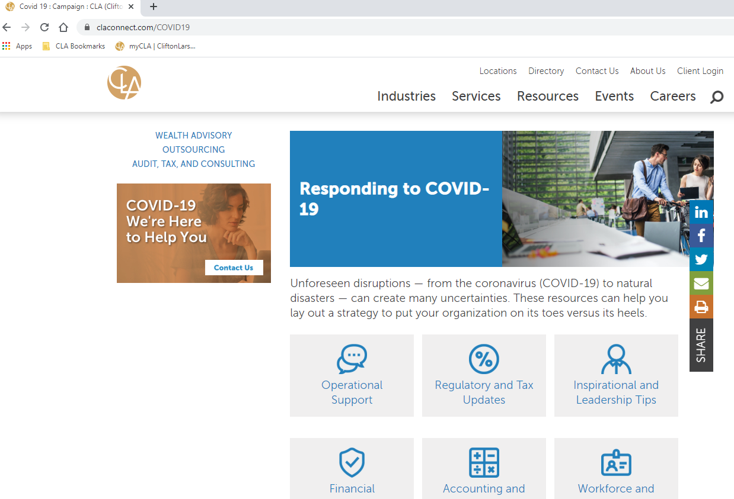
Resources – CLA COVID-19 Home Page

Slide 20
Questions?
Melissa Murphy, CPA
Manager, Nonprofit
Melissa.Murphy@CLAconnect.com
617-984-4443
Tim Warren, CPA
Principal, Nonprofit and Higher Education
Tim.Warren@CLAconnect.com
617-984-8143

