Slide 1
Learning to Love (or at Least Live with)
Restricted Revenue:
Creative Use of New Nonprofit Accounting Standards
Nonprofit Financial Managers
December 5, 2019
Notes:
Melissa/Danielle

Slide 2
Learning Objectives
Describe the new revenue recognition standards and related risks
Discuss key concepts for new standards.
  Revenue assessment (ASU 2014-09 Topic 606)
  Grant assessment (ASU 2018-08)
  Communications
Identify where and how to apply the new standards in accounting practices, when creating financial reports, and in crafting grant proposals and budgets to create more flexible funding
Notes:
Melissa/Danielle

Slide 3
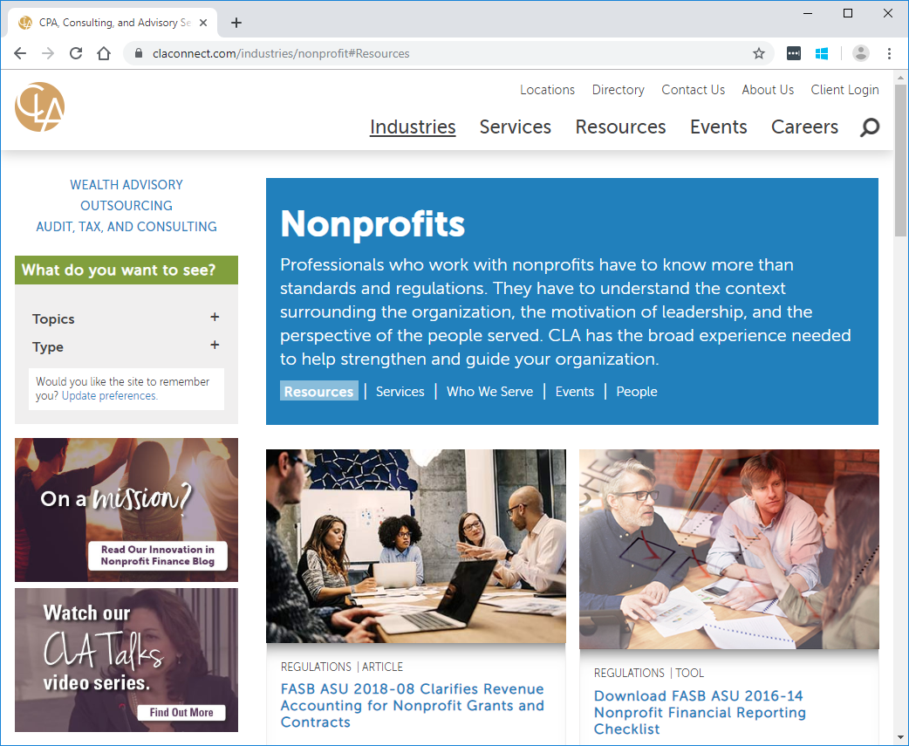
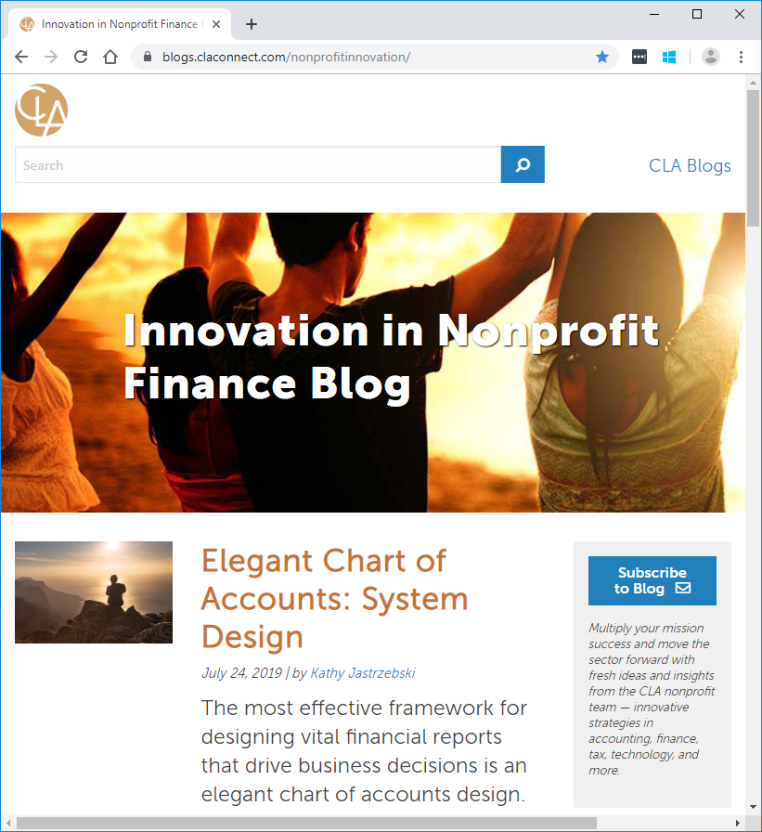

CLA Implementation Assistance (CLAconnect.com)
Notes:
Melissa/Danielle

Slide 4

Use Accounting Standards to Inspire
Never let an accounting standard get you down
Learn enough about accounting to avoid being a victim of the accounting
Notes:
Tim

Slide 5
What’s All This About Revenue Recognition?
There are new FASB standards that clarify
when we can report the revenue we receive and
when we can use it.
Today we’ll talk about how it affects
  Contracts and things like contracts
  Contributions and things like contributions
Notes:
Tim

Slide 6
Revenue Recognition – Effective Dates
Deferred effective dates (pretty much now!)
    CY 2018 (FY 2018-19) for public entities* (including interim)
    CY 2019 (FY 2019-20) for nonpublic entities (no interim, just annual period; interims in subsequent years)
    Early adoption permitted, but not before original effective date
* Public entities include NFPs with publicly traded conduit (or direct) debt
Notes:
Tim

Slide 7
Exchange transactions (contracts and contract-like)
- Steps for recognizing revenue under Topic 606 guidance
Notes:
Melissa/Danielle

Slide 8
Revenue Recognition (Topic 606) – Applies to Exchange Transactions
Core Principle:
Steps to apply the core principle:
Recognize revenue to depict the transfer of promised goods or services to customers in an amount that reflects the consideration to which the entity expects to be entitled in exchange for those goods or services
1. Identify
contract(s) with the customer
2. Identify performance obligations
3. Determine transaction price
4. Allocate
transaction price
5. Recognize revenue when (or as) a performance obligation is satisfied
Notes:
Melissa/Danielle
Step 1: Identify the contract
Existence: Must meet specified criteria to apply the model, including a collectability threshold (probable of collecting consideration in which it will be entitled to)
Combining Contracts: Can use portfolio method if contracts (1) negotiated as a package (2) amount of consideration depends on price/performance of other contract (3) goods or services form a single performance obligation
Step 2: Identify the performance obligations (promise to transfer distinct good or service)
Capable of being distinct (customer can benefit from good service on its own or from readily available sources) AND
Distinct within the context of the contract (separately identifiable – 3 criteria)
Step 3: Determine the transaction price
Variable consideration constraint: Include in transaction price variable amounts only to an extent that it is probable that a significant reversal in the amount of cumulative revenue recognized will not occur when the uncertainty is resolved (for licenses of IP, include sales or usage-based royalties in transaction price when the sales or usage occurs)
Significant financing component: Adjust consideration if timing of payment provides customer or entity with significant benefit of financing
Step 4: Allocate the transaction price to the performance obligations
Allocate on relative standalone selling price basis (estimate if not observable)
Discounts and contingent amounts allocated entirely to specific POs if specified criteria are met
Step 5: Recognize revenue when or as the entity satisfies a performance obligation
Recognize revenue over time if specified criteria met:
Customer receives and consumes benefits as entity performs (ex: cleaning service)
Entity’s performance creates or enhances asset that customer controls (ex: home addition)
Entity’s performance does not create an asset with an alternative use and entity has right to payment for performance completed to date
Recognize revenue at a point in time if criteria not yet. (when customer obtains control → indicators: present right to payment, legal title, physical possession, risks and rewards of ownership, customer acceptance)

Slide 9
Applying Revenue Recognition to Exchange Transactions
Step 1 –
Identify
contract(s) with the customer
A contract is an agreement between two or more parties that creates enforceable rights and obligations. Enforceability of the rights and obligations in the contract is a matter of law. Contracts can be written, oral, or implied by an entity’s customary business practices. The practices and processes for establishing contracts with customers vary across legal jurisdictions, industries, and entities. […]
The definition goes on from 606-10-25-2 through 606-10-25-8
9
Notes:
Melissa/Danielle

Slide 10

Applying Revenue Recognition to Exchange Transactions
Step 2 –
Identify performance obligations
A performance obligation is a promise in a contract with a customer to transfer a good or service to the customer. If an entity promises in a contract to transfer more than one good or service to the customer, the entity should account for each promised good or service as a performance obligation only if it is (1) distinct or (2) a series of distinct goods or services that are substantially the same and have the same pattern of transfer.
Step 3 – Determine transaction price
The transaction price is the amount of consideration (for example, payment) to which an entity expects to be entitled in exchange for transferring promised goods or services to a customer, excluding amounts collected on behalf of third parties.
10
Notes:
Melissa/Danielle

Slide 11
Applying Revenue Recognition to Exchange Transactions
Step 4 – Allocate
transaction price
For a contract that has more than one performance obligation, an entity should allocate the transaction price to each performance obligation in an amount that depicts the amount of consideration to which the entity expects to be entitled in exchange for satisfying each performance obligation.
Step 5 –
Recognize revenue when (or as) a performance obligation is satisfied
An entity should recognize revenue when (or as) it satisfies a performance obligation by transferring a promised good or service to a customer. A good or service is transferred when (or as) the customer obtains control of that good or service.
11
Notes:
Melissa/Danielle

Slide 12
Clarify the difference between:
- reciprocal/exchange (contract-like) transactions
- nonreciprocal/nonexchange (contribution-like) transactions
Notes:
Tim

Slide 13
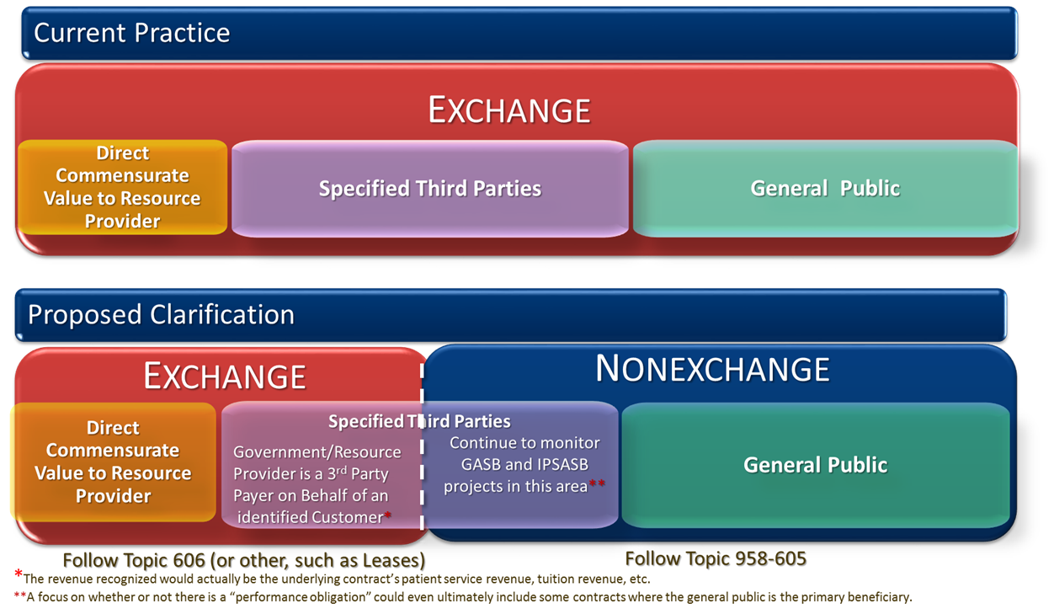
Accounting Standards Update No. 2018-08
Clarifying the Scope and the Accounting Guidance for Contributions Received and Contributions Made
Notes:
Tim

Slide 14
Reciprocal vs. Nonreciprocal Transactions:
Key Clarifications to the Scope of Subtopic 958-605
The final ASU clarified and refined existing guidance in Subtopic 958-605 by adding paragraphs that would clarify the scope of the Subtopic as well as illustrative examples.
The resource provider is not synonymous with the general public, even a governmental entity. If a resource provider receives value indirectly by providing a societal benefit, this would be considered a nonreciprocal transaction.
If the primary beneficiary of a grant or contract is a third party, an NFP must use judgment to determine if the transaction is reciprocal or nonreciprocal.
Furthering a resource provider’s mission or “feel good” sentiment does not constitute commensurate value received.
The type of resource provider should not override the substance of the transaction.
Notes:
Tim

Slide 15
Questions about Terminology – What’s in a Name?
The term used in the presentation of financial statements to label revenue (for example, contribution, grant, donation) that is accounted for within the Scope of Subtopic 958-605 is not a factor for determining whether an agreement is within the scope of that guidance.
There is no expectation for recipients or makers to call their grants “contributions” in their statements. They will likely continue to call them “grants and contracts,” “government grants,” or another suitable label.
Rather, recipients and makers are simply using the guidance in the contribution model in Subtopic 958-605 (-720) to determine revenue (expense) recognition for transactions that are nonexchange (nonreciprocal) transactions.
Notes:
Tim

Slide 16
Contributions and Grants
- Conditional vs. Unconditional Contributions
- Disclosure Requirements
Notes:
Melissa/Danielle

Slide 17
Conditional vs. Unconditional Contributions
For a Donor-Imposed Condition to Exist:
Final ASU
A right of return or release must exist
AND
The agreement must include a barrier
Remember: Conditions are different from Restrictions
Notes:
Melissa/Danielle

Slide 18
Indicators that a barrier may exist
✓
✓
✓
There is a measurable performance-related barrier
There is a stipulation that limits discretion on the conduct of an activity
The extent to which a stipulation is related to the purpose of the agreement
Specified Level of Service
Specific output or outcome
Matching
Milestone
Allows only qualifying expenses
Requires a specified protocol
Required to hire specific individuals
YES: Convey research findings
NO: General report on activities
NO: Requirement for annual audit
Notes:
Melissa/Danielle

Slide 19
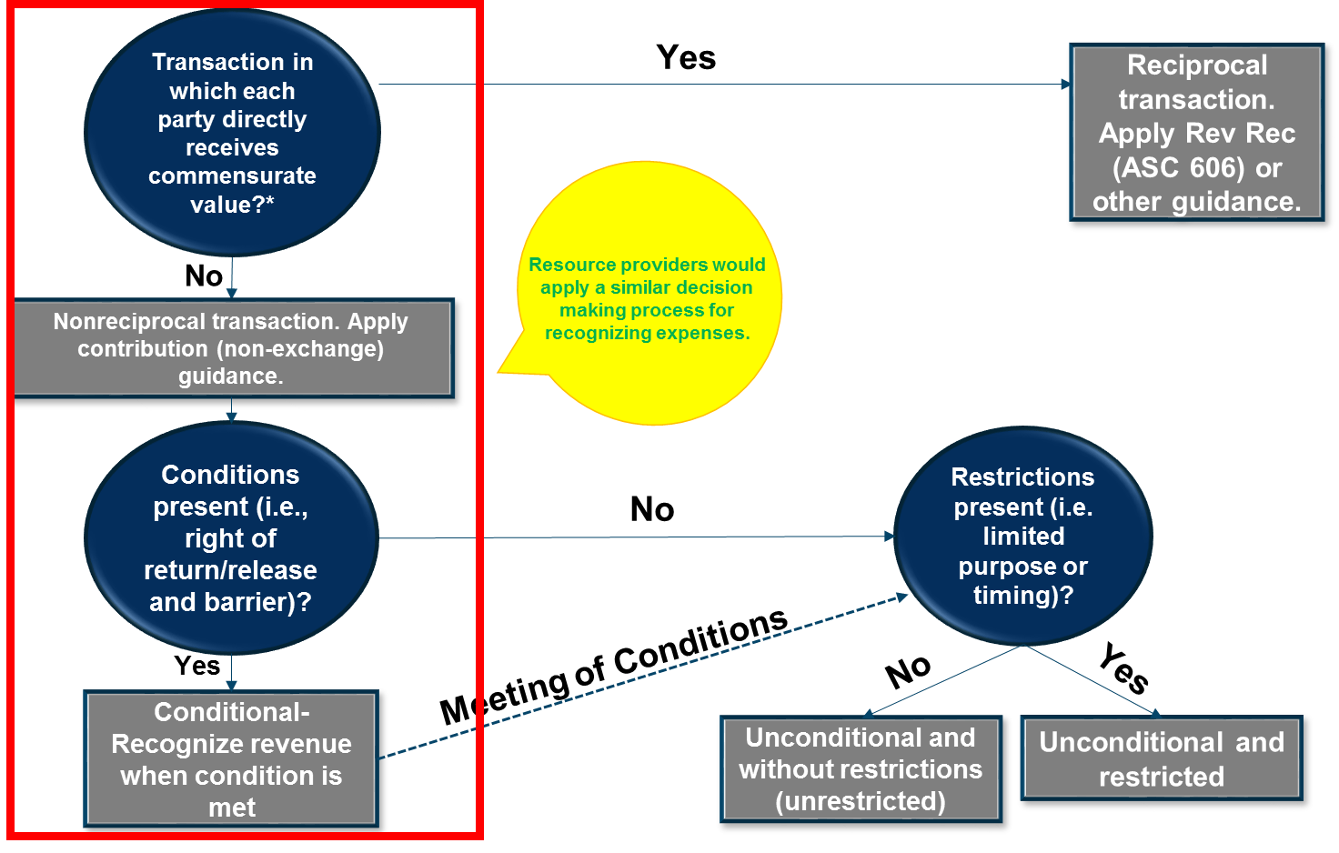
NFP Revenue Recognition Decision Process
*Includes third-party payments on behalf of identified customers. These do not create new revenue.
Notes:
Melissa/Danielle

Slide 20
DISCUSSION 1:
Have you ever received grants
or contributions where it was difficult to determine if there was a condition or if it was simply a restriction?
Has your organization, or any that you know, ever had to return contribution revenue and for what reasons?
Notes:
Melissa/Danielle

Slide 21
Managing Revenue Recognition
- How to Craft Proposals to Mitigate Restrictions
- How to Control the Timing of Recognition
Notes:
Tim

Slide 22

22
Sometimes Our Restrictions are of Our Own Making
Donor intent determines restrictions and conditions
Donor intent is often based on how we ask
    Grant proposals
    Campaign letters
    Website appeals
Grant award notices and cover letters reference
our proposal narratives
Proposal budgets themselves can determine
grant restrictions and conditions
Notes:
Tim

Slide 23

23
Be Artful of What You Ask For
Write the biggest proposal you can
Include all of your programs
or as many as possible
Tie use of funds to the way
you already do business
Always write towards your outcomes
Notes:
Tim

Slide 24
24
Strategies to Manage When Grant Revenue is Booked
Using Accounting to Purposefully Place Conditions on Grants
Donor-imposed conditions are different from restrictions
A conditional gift is not recognized – meaning it does not show up in our financial statements – until the “conditions” stipulated by the donor are satisfied
ASU 2018-08 spells out circumstances that create a condition.
  Right of return / release
  Barrier(s)
How we draft our proposal narratives and budgets matters
Notes:
Tim

Slide 25
Adding the Right Language to Proposals and Agreements
Write a condition into our proposal
Consider a condition that syncs with our natural flow of work:
  A matching funds requirements
  A requirement that a certain certification or government approval be secured
  A measurable performance threshold that must be met within a certain time
Ask the grant administrator to attach a condition to the agreement
These are all valid strategies for managing
when contributions are booked
Notes:
Tim

Slide 26
26
Example:
Mitigating the Consequences of Large, Multi-Year Grants
It’s All About Timing
The entire amount of unconditional grants must be booked at the time the grant is awarded
Actual cash may not be received until one or more years later
Releasing years two and later of a multi-year grant may cause a negative change in total net assets
Difficult to educate statement users that change in net assets without donor restrictions is a better measure of operations
Notes:
Tim

Slide 27
27
Notes:
Melissa/Danielle

Slide 28
Notes:
Melissa/Danielle

Slide 29
29
Notes:
Melissa/Danielle

Slide 30
DISCUSSION 2:
What are some barriers you
could imagine adding to the
3-year grant in the example above to create conditions?
Does your organization receive multi-year grants and what effect has it had on your financial statements?
Notes:
Melissa/Danielle

Slide 31
Getting Creative with the Accounting
- One way to manage restrictions and conditions
Notes:
Tim

Slide 32
Getting Creative with Accounting (the ethical kind of creative)
Even though the principles found in Topic 606 on revenue recognition apply only to reciprocal / exchange transactions (contracts and contract-like agreements), we can creatively adapt those principles to nonreciprocal transactions (grants and contributions covered in Topic 605).
A contribution (grant) is not an exchange transaction. It is nonreciprocal. It does not constitute a contract between the funder and nonprofit (no vendor and customer arrangement).
Notes:
Tim

Slide 33
Getting Creative with Accounting (the ethical kind of creative)
In order to allow us better control over when a restricted grant is released or to intentionally create conditions on a contribution, we can prepare a different type of proposal budget – a deliverable-based budget.
Deliverables (performance obligations) are a concept from topic 606, which applies to contracts. But we can use the concept with contributions to help control the timing of releases of restriction or to add conditions.
Notes:
Tim

Slide 34
34
Example: Deliverable-Based Proposal Budget
Sample Nonprofit has civic engagement as its mission
Proposes to offer 10 educational workshops about city government
Proposes to offer two guided tours of city council meetings to teach residents to better engage with their elected officials
Budget asks for $100,000
Budget is designed to fully fund the work and contribute appropriately to the financial needs of the entire organization
Notes:
Tim

Slide 35
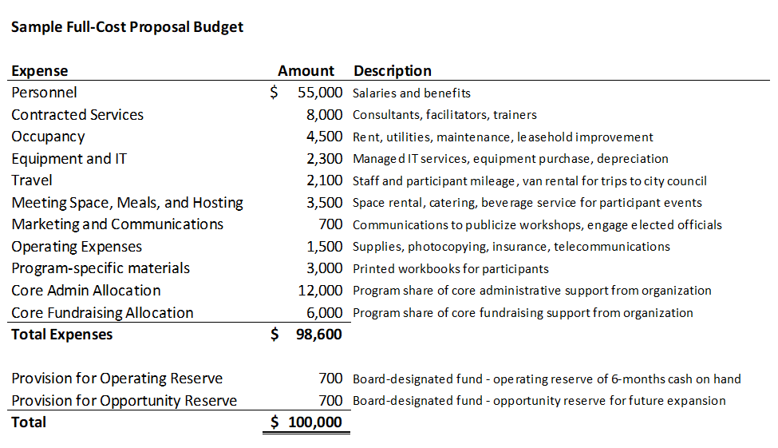
35
To make sure we cover all costs, we start by building a traditional line-item budget
Notes:
Tim

Slide 36
36
Next we reformat that budget to capture all the deliverables we are promising
Notes:
Tim

Slide 37
Going Beyond the Standards
Adapting Concepts from Topic 606 to Create Restrictions or Conditions
1. Identify
contract(s) with the customer
Step 1) Instead of a contract, we are working with a grant agreement or contribution receipt or award transmittal letter.
Step 2) Instead of performance obligations, we draft our proposal narrative to describe deliverables. In our sample case, a civic engagement organization, the deliverables are 10 workshops and two guided tours.
2. Identify performance obligations
37
Notes:
Melissa/Danielle

Slide 38
Applying Revenue Recognition to Revenue Release
Step 3) Instead of determining transaction price, a nonprofit would establish the total amount of support being asked for in the proposal. In our example, the total amount is $100,000.
3. Determine transaction price
Step 4) Instead of allocating the transaction price, we would allocate the total amount of support to the various deliverables. In our example, each workshop requires $9,000 of support and each guided tour requires $5,000.
4. Allocate
transaction price
38
Notes:
Melissa/Danielle

Slide 39
Applying Revenue Recognition to Revenue Release
Step 5) Instead of recognizing the revenue as a performance obligation is satisfied, for a contribution we would simply release the revenue as the deliverable was completed.
5. Recognize revenue when (or as) a performance obligation is satisfied
Note: If desired, you could craft your proposal narrative and proposal budget in such a way as to make the “deliverables” act as conditions for the contribution. Then the revenue would not be recognized until the deliverable was completed (the condition met).
39
Notes:
Melissa/Danielle

Slide 40
40
Developing a Deliverable-Based Proposal Budget
The beauty of a deliverable-based budget design
Ease of tracking and releasing the restrictions on the award
Properly plan and calculate to cover the full costs of the proposed program
Incremental release will cover the direct program expenses, the necessary core infrastructure costs, and reserves of the organization.
Design it so that deliverables behave as conditions in order to time when revenue is recognized.
Notes:
Melissa/Danielle

Slide 41

Shaping Your Ask
We may have been restricting ourselves
Be sure we understand the accounting
Craft narratives and budgets purposefully
  deliverable-based budgets
  purposefully including conditions
We can control how restrictions and conditions behave
Notes:
Tim

Slide 42
Additional Resources
Article: FASB ASU 2018-08 Clarifies Revenue Accounting for Nonprofit Grants and Contracts
https://www.claconnect.com/resources/articles/2018/fasb-clarifies-revenue-accounting-for-nonprofit-grants-and-contracts
Article: Shaping Your Ask: How Nonprofits Can Learn to Love Restricted Revenue
https://www.claconnect.com/resources/articles/2019/shaping-your-ask-how-nonprofits-can-learn-to-love-restricted-revenue
Short Video: It’s Time for Associations to Take Action on Revenue Recognition
https://www.claconnect.com/resources/videos/2018/cla-talks-video-revenue-recognition
Webinar: Impact of Revenue Recognition Standards
https://www.claconnect.com/events/2016/impact-of-proposed-revenue-recognition-standards-12-08-2016
Tool: Center for Audit Quality Implementation Tool:
https://www.thecaq.org/preparing-new-revenue-recognition-standard-tool-audit-committees
Notes:
Tim

Slide 43
Subscribe to our New Blog! Read about innovation in nonprofit finance.
CLAconnect.com/Npblog
Follow us on LinkedIn: CLA (CliftonLarsonAllen)
Like us on Facebook: CLA (CliftonLarsonAllen)
Follow us on Twitter: CLA_Nonprofit
Subscribe to our emails and get insights delivered right to your inbox.
CLAconnect.com/subscribe
Stay Connected with CLA!
Notes:
Tim

Slide 44
Questions?
Melissa Murphy, CPA
Manager, Nonprofit
Melissa.Murphy@CLAconnect.com
617-984-4443
Tim Warren, CPA
Principal, Nonprofit and Higher Education
Tim.Warren@CLAconnect.com
617-984-8143

