Slide 1
Health Connector for Business: Affordable, Flexible Health Coverage
Mahealthconnector.org/business
MARCH 2024

Slide 2
What is the Health Connector?
The Massachusetts Health Connector is the State’s health insurance Marketplace. It offers individuals, families, and small employers access to affordable health insurance coverage.
People who don’t get health insurance through their job or other sources may apply for individual coverage
Businesses can offer small group coverage to their employees through the Health Connector for Business available to small employers with less than 50 FTE employees.
Employers can also offer dental insurance through the Health Connector

Slide 3
Health Connector Plans
All the plans sold through the Health Connector meet state and federal standards for coverage. Plans are available through leading MA insurers, with exclusive cost-savings and flexible choice benefits.

Slide 4
Covered Benefits
All Health Connector plans cover a comprehensive range of benefits that are required to meet the state’s minimum coverage standard:
Office visits
Emergency Services
Hospitalization
Maternity and Newborn Care
Preventive services with zero cost sharing
Pediatric Care
Prescription Drugs
Rehabilitation Services
Lab Services
Mental Health and Substance Use Treatment
Learn more at www.mahealthconnector.org/stay-covered

Slide 5
Health Connector for Business

Slide 6
Benefits of Health Connector for Business
The Health Connector seeks to maximize access and affordability for small employers in Massachusetts. To achieve those goals, across a range of dimensions, Health Connector for Business offers small employers in Massachusetts unprecedented flexibility, choice, and savings opportunities.
FULL CARRIER PARTICIPATION
FLEXIBLE EMPLOYEE CHOICE
Only place where small groups can access every single leading carrier in the marketplace
Employers can allow employees to shop for different plans that fit their needs, all while keeping employer costs constant
COMPETITIVE PREMIUMS
CERTIFIED ASSISTANCE
Small businesses save over 20 percent on average, before any rebates
Over 460 certified brokers are available to help employers decide which plan options are best for their businesses
WELLNESS REBATES
Employers may be eligible for a 15% rebate of their premium contributions if employees complete one of 30+ approved wellness activities
PEACE OF MIND
Employers can feel secure that all plans meet federal and state coverage requirements

Slide 7
Health Connector for Business Plan Highlights
Health Savings Account Plans
A health savings account is a tax-advantaged medical savings account available to taxpayers in the United States who are enrolled in a high-deductible health plan. Each carrier offers a silver HSA compatible plan.
Out of State Coverage
Health Connector for Business offers out-of-state coverage with new Preferred Provider Organization plans. To access the PPO plan, employers will need to offer the “One Carrier” model.
Coverage You Can Trust
All Health Connector for Business plans are compliant with state and federal law, meet the state’s “minimal credible coverage” standard, and have received the Health Connector Seal of Approval for quality and value.

Slide 8
Comparison Shopping Leading to Savings for Small Businesses and their Workers
Small businesses save over 20 percent on average by shopping through Health Connector for Business, before any rebates.
In aggregate, these competitive dynamics result in small employers and their employees in Massachusetts collectively saving nearly $9M per year on health insurance premiums by shopping through the Health Connector for business compared to similar groups off-Exchange.

Slide 9
Employee Choice Models

Slide 10
Employee Choice Models
Employer can control costs while providing multiple insurance options to employees
Employees can easily compare options and choose a plan that fits their needs

Slide 11
Employees Can Choose Their Own Plans
ONE PLAN | ONE CARRIER | ONE LEVEL
Employer Selects One Plan The employee is enrolled in the selected plan Composite billing method Bronze plans can only be offered through this model | Employer Selects One Carrier The employee can choose any plan within the selected carrier List billing method PPO options can only be offered through this model (except for Tufts Direct, WellSense, and Fallon) | Employer Selects Metallic Tier The employee can choose any plan within the selected tier List billing method Only a silver or gold tier can be offered through this model PPO plans are available at the Silver tier only.

Slide 12
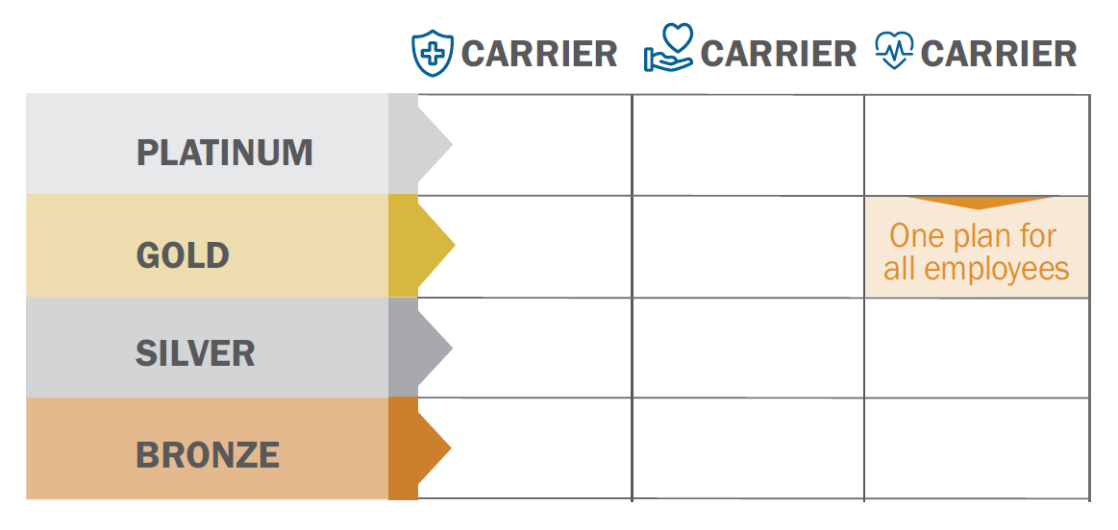
One Plan
Employer selects one health plan
All employees enroll in the plan
Composite billing method

Slide 13
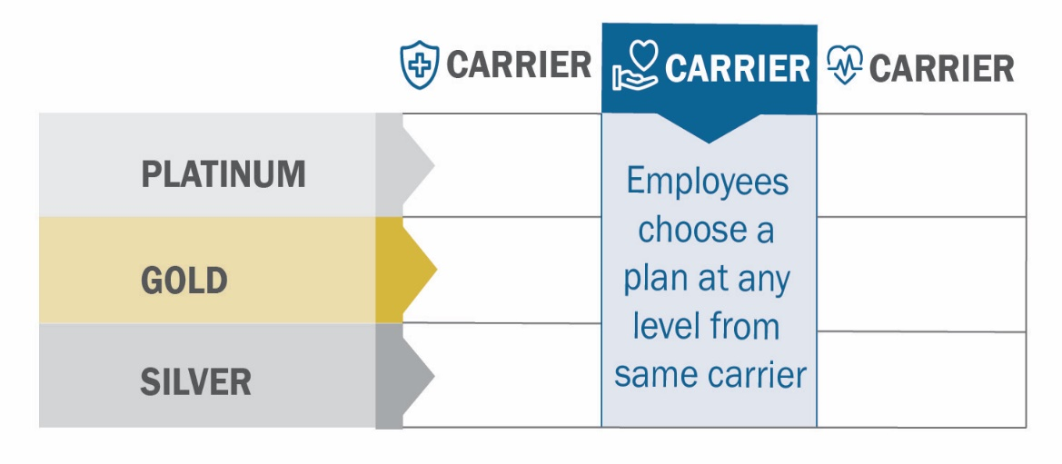
One Carrier
Employer selects one carrier
The employee can choose a plan at different metal levels offered by the carrier
List billing method

Slide 14
One Level
Employer selects a metal level and a Reference Plan within that level to use as a cost benchmark
The employee can choose a health plan offered by any carrier within the selected metal level
List billing method

Slide 15
Additional Opportunities for Savings

Slide 16
ConnectWell
Businesses qualify for ConnectWell if they have 25 or fewer enrolled employees. To participate, employees can choose from more than 30 qualifying wellness activities.
Employers can receive a 15 percent rebate on their contributions towards premiums for the year if 33 percent of employees participate in a wellness activity. The average ConnectWell rebate was $2,900 in 2020.
Employees who participate will earn a $100 Visa Gift Card
Employees can choose from a range of over 30+ approved wellness activities including activities they can complete at home.

Slide 17
ConnectWell Process
Employees are Emailed
Employees Receive Gift Cards
Receive Rebate
Employees who complete an activity receive a $100 Visa gift card
At year end, you will receive a rebate worth 15% of your annual premium contributions
Employees are sent emails about incentives and how to participate
Auto-Enrolled
Employees Complete Activities
33% Participation Reached
If your group is eligible, you are automatically enrolled and emailed 10 days after your plan starts
Employees submit proof that they have completed one of the approved activities
You will receive bi-monthly updates about your participation rate. Once you hit 33% you are rebate eligible!

Slide 18
“We heard that there would be a 15% rebate and I said ‘Yeah, I’ll believe it when I see it,’ and here it is!”
Small Business Owner:
Marcie Berger
Owner, Clean Properties

Slide 19
Small Business Health Care Tax Credit
Small businesses may be eligible for up to a 50% tax credit (tax-exempt employers may be eligible for up to a 35% tax credit) if they purchase coverage through the Health Connector.
To be eligible, employers must:
Be enrolled in the Health Connector for Business
Have fewer than 25 full-time equivalent employees (FTEs) and those employees must have average wages of less than $56,000 (2022) a year – (excludes the owner, partner in a partnership, shareholder of S Corporation owning more than 2%, owner of more than 5% of other businesses, and family)
The tax credit is highest for employers with fewer than 10 employees who are paid an average of $25,000 or less – the smaller the business, the bigger the credit
Employers can claim the tax credit for up to two consecutive years
For more information, visit: www.irs.gov/affordable-care-act/employers/small-business-health-care-tax-credit-and-the-shop-marketplace or https://www.taxpayeradvocate.irs.gov/estimator/premiumtaxcreditchange/index.htm

Slide 20
Example Enrollment Timeline
How to Get Started
Visit Website
Employers Shop
for Plan
Employees Shop
for Plan
Online Payment
Coverage
Begins
Deadline 10th
Deadline 20th
Deadline 23rd
1st of the Month

Slide 21
Benefits of Using a Broker
The Health Connector for Business has over 460 certified brokers.
Find a broker at: https://my.mahealthconnector.org/directory/categories/small-businesses
Free to Use
Understand Plan Options
Brokers will create plan options and help you enroll in coverage at no cost to you
Brokers can help you compare available plans to understand which plan is best for your group
Easy Cost Estimates
Save Time
Brokers can provide you cost estimates for different plans without the need for you to create an employer account
Brokers will help manage the enrollment process and plan creation so that you can spend time on what’s important for your business

Slide 22
Reminders and details about shopping and enrollment on MAhealthconnector.org
Small Business employees and owners that do not qualify to offer coverage on the Health Connector for Business can get coverage on MAhealthconnector.org
Small Business employees and owners that DO qualify to offer coverage on the Health Connector for Business must follow these deadlines:
10th of the month -- Deadline for employer to create account, upload all FT employees, quarterly wage document and publish the benefit package (Open Enrollment) in employer online account.
20th of the month -- Deadline for employees to create accounts and enroll or waive with a valid waiver
23rd of the month -- Deadline for employer to make 1st Initial Binder payment online in the Billing portal

Slide 23
Questions

Slide 24
Shop and Enroll Online at
www.mahealthconnector.org/business
or call 1-888-813-9220

